Slide 1

ECE 478-578 Intelligent Robotics I
PhD. Husnu Melih Erdogan – Electrical & Computer Engineering
herdogan@pdx.edu Teaching Assistant – Lab Assistant

Slide 2


ROS Dynamixel Servo Control

Slide 3
ROS Dynamixel Packages

Slide 4
ROS Dynamixel Packages
There quite many available ROS packages you can use to control Dynamixel servos. Some of them are:
Robotis
DynamixelSDK
Dynamixel_motor
Arbotix

Slide 5
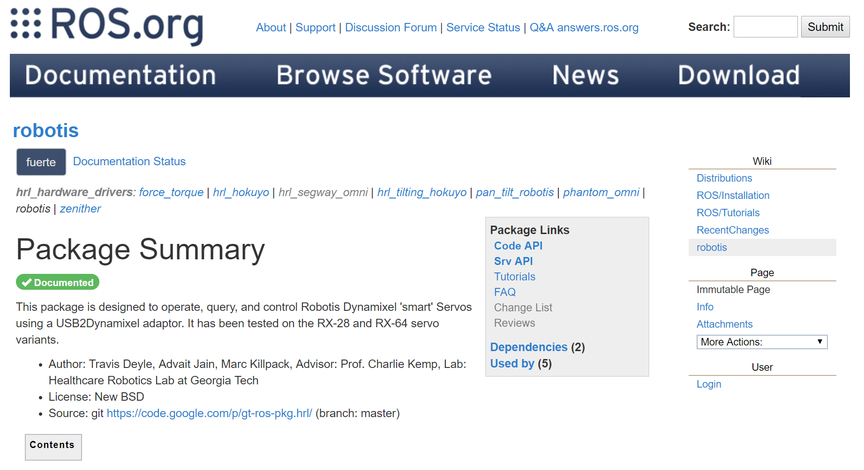
robotis

Slide 6
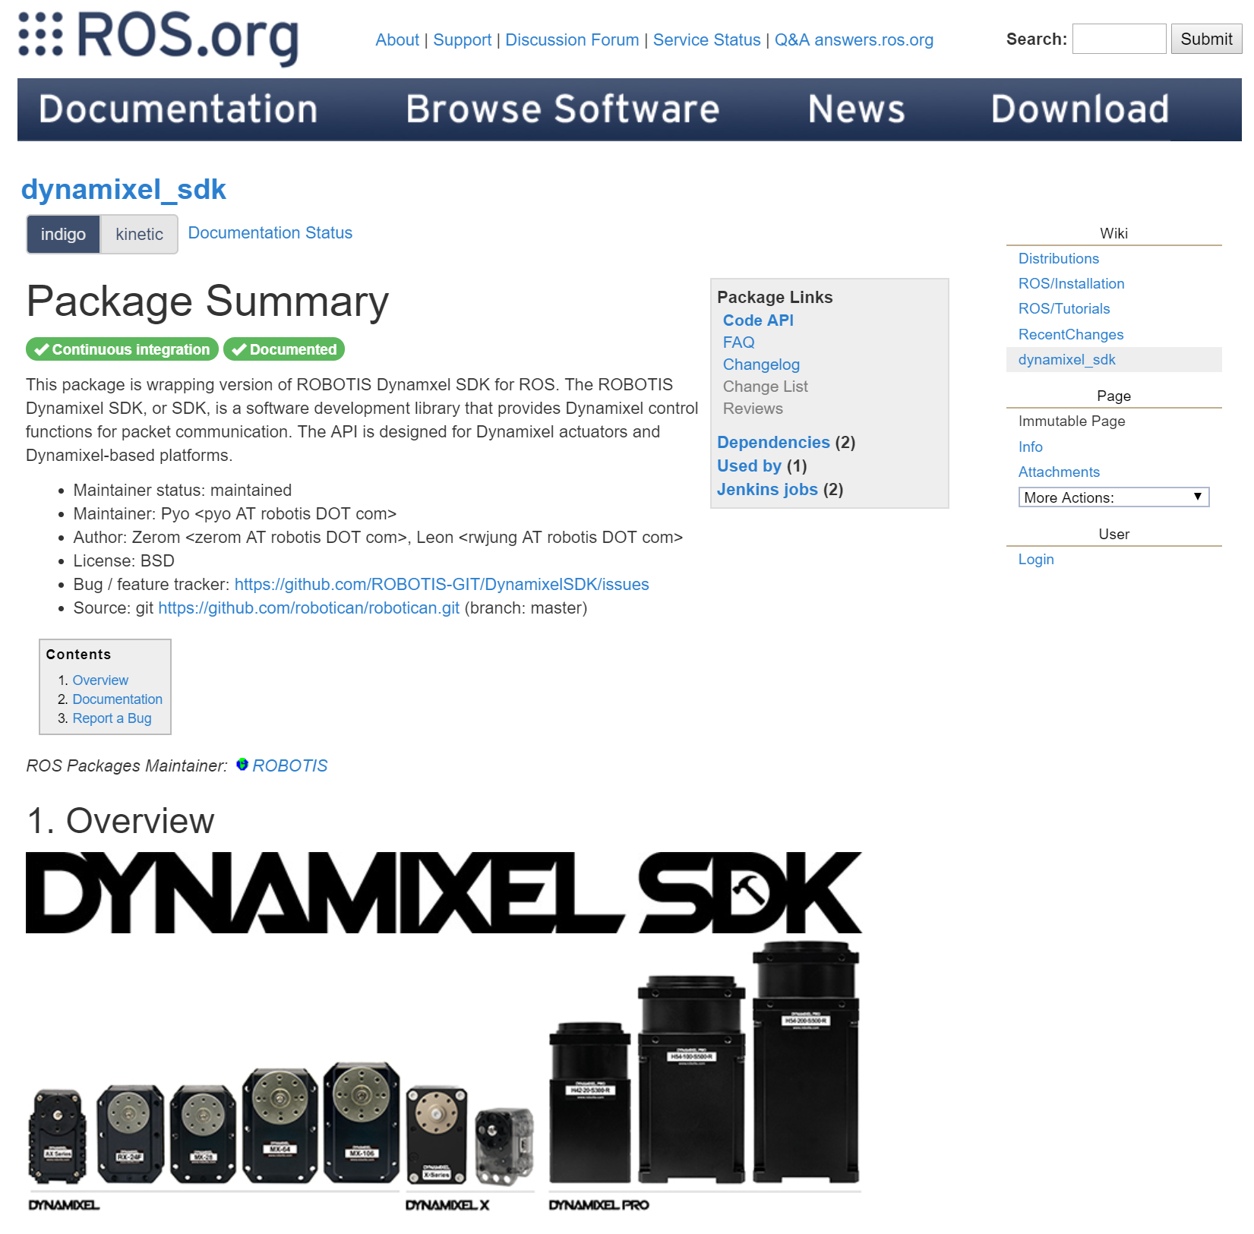
Dynamixel SDK

Slide 7
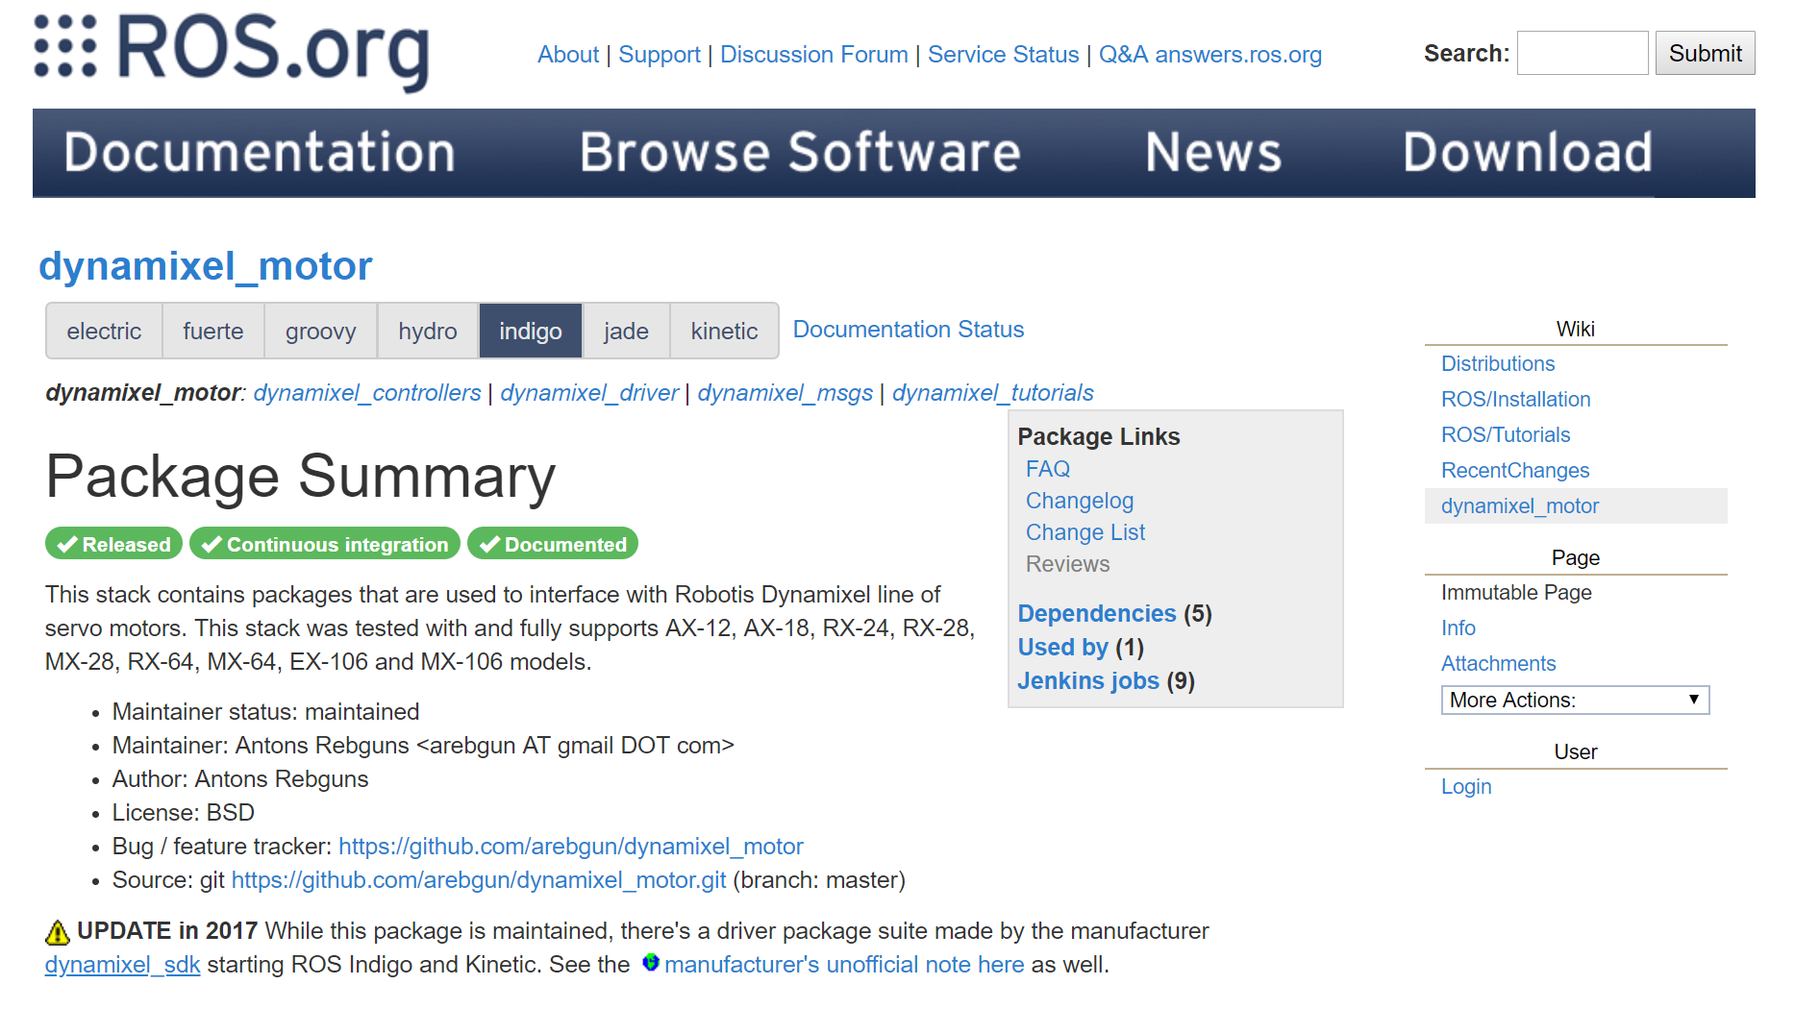
Dynamixel_motor

Slide 8
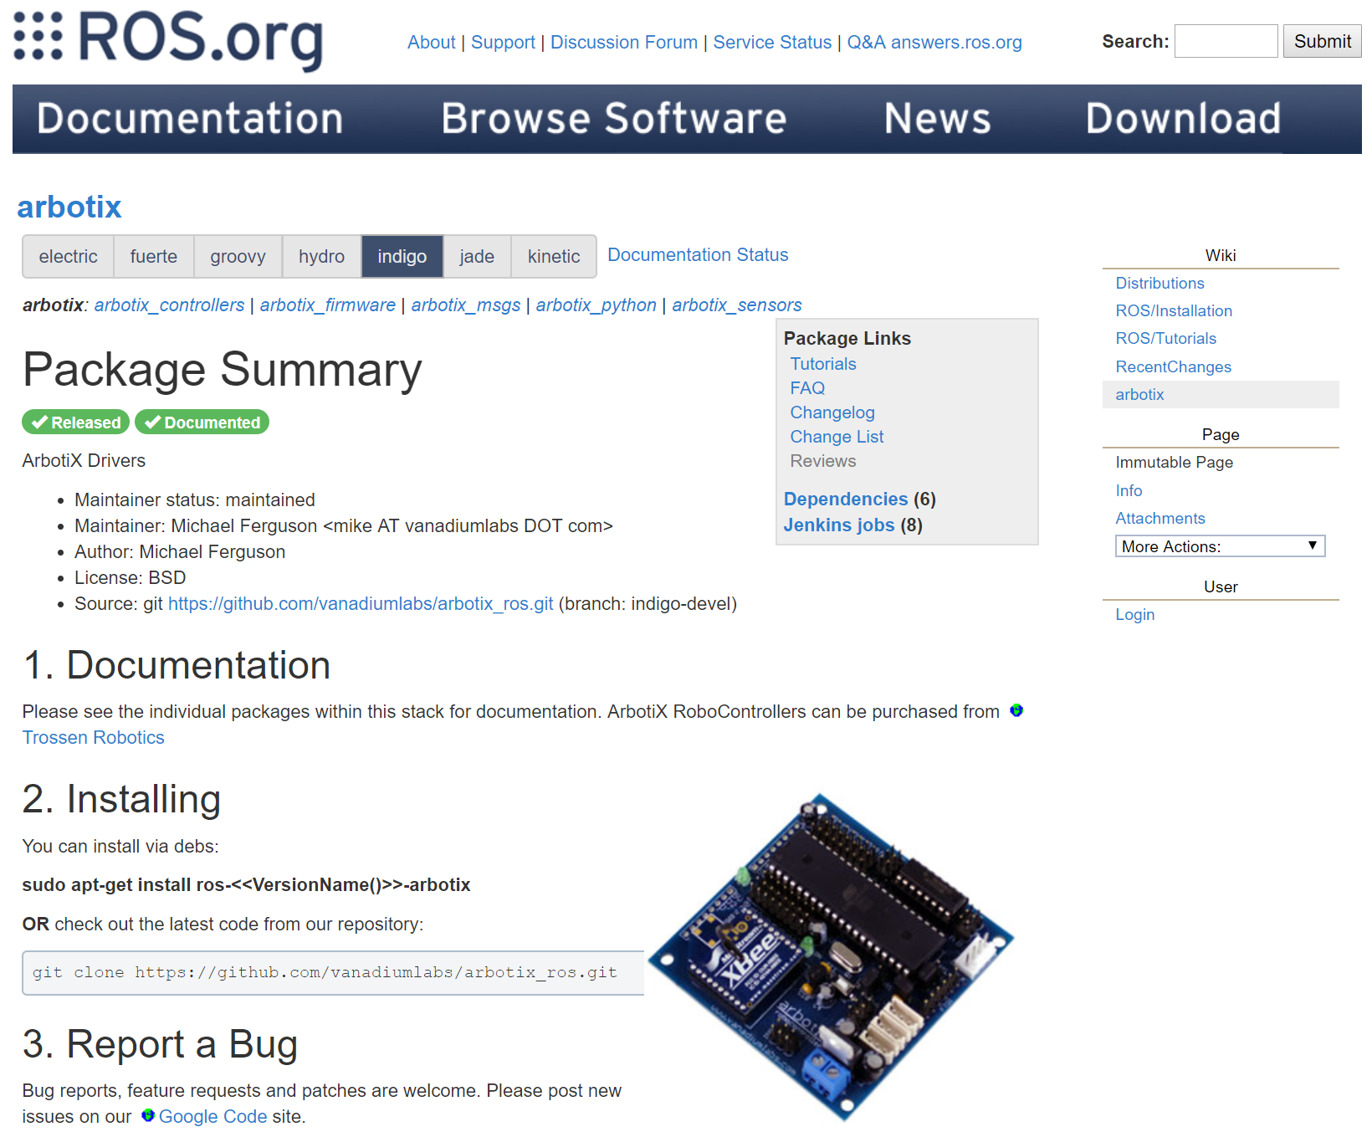
Arbotix – Arbotix M Contollers

Slide 9
Dynamixel_motor
It seems like a package, but it is actually a stack. It contains many other packages that are necessary to control dynamixel servos.
Dynamixel_controllers
Dynamixel_driver
Dynamixel_msgs
Dynamixel_tutorials
It supports AX-12, AX-18, RX-24, RX-28, MX-28, RX-64, MX-64, EX-106 and MX-106 models.
It also works with USB2Dynamixel adaptor.

Slide 10
How to install these packages
You can install it from the ROS Ubuntu package repository
sudo apt-get install ros-indigo-dynamixel-motor
You can also build it from scource
cd catkin_ws/src
git clone https://github.com/arebgun/dynamixel_motor
cd ..
catkin_make

Slide 11
Dynamixel_controllers
This package contains a configurable node, services and a script to start, stop and restart one or more controller plugins.
Reusable controller types are defined for common Dynamixel motor joints.
Both speed and torque can be set for each joint.
This python package can be used by more specific robot controllers and all configurable parameters can be loaded via a yaml file.

Slide 12
Dynamixel_driver
This package provides low level IO for Robotis Dynamixel servos.
Fully supports and was tested with AX-12, AX-18, RX-24, RX-28, MX-28, RX-64, EX-106 models. Hardware specific constants are defined for reading and writing information from/to Dynamixel servos.
This low level package won't be used directly by most ROS users. The higher level dynamixel_controllers and specific robot joint controllers make use of this package.

Slide 13
Dynamixel_msgs
Custom msgs used in the dynamixel_motor stack
JointState.msg
MotorState.msg
MotorStateList.msg

Slide 14
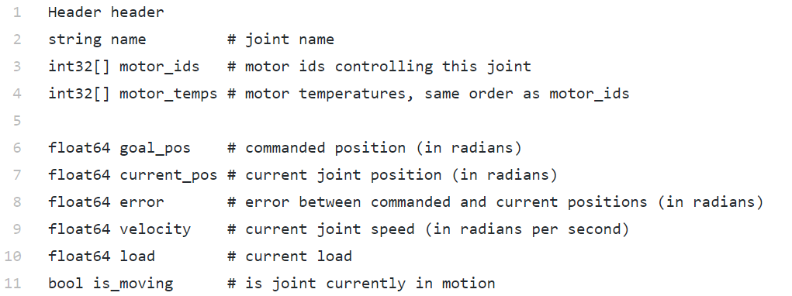
JointState.msg

Slide 15
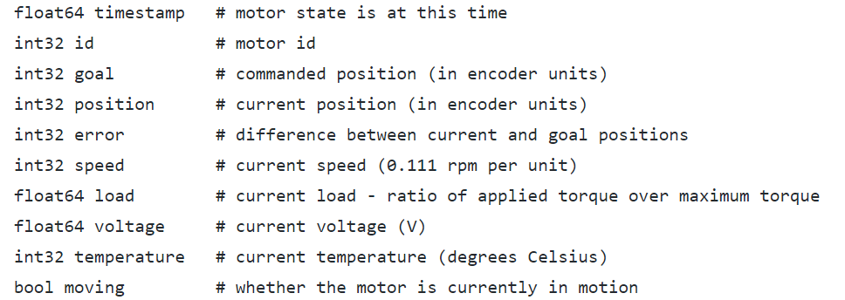
MotorState.msg

Slide 16
MotorStateList.msg

Slide 17
dynamixel_tutorials
This package contains some tutorials to learn how to use it.

Slide 18
Setting Up Dynamixel Controller Package

Slide 19
Create a new package for your robot
cd catkin_ws/src
catkin_create_pkg the_walker dynamixel_controllers std_msgs rospy roscpp

Slide 20
Create a launch file for the manager node
We assume that the Dynamixel servos are connected to /dev/ttyUSB0 serial port.
If you can’t access to the device via the USB port
sudo apt-get purge modemmanager
sudo usermod -a -G dialout $USER
sudo reboot
First we need to start up the controller manager that will connect to the motors and publish raw feedback data (e.g. current position, goal position, error, etc.) at a specified rate.
The easiest way to do that is to write a launch file that will set all necessary parameters. Let's copy and paste the following text into a controller_manager.launch file.

Slide 21
Create a launch file for the manager node
First we need to start up the controller manager that will connect to the motors and publish raw feedback data:
current position
goal position
Error
at a specified rate.
The simplest way to do that is to writing a launch file that will set all necessary parameters.

Slide 22
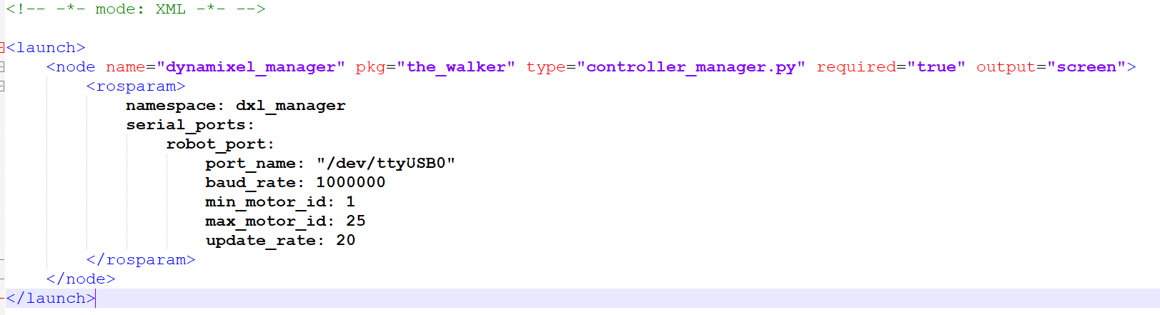
Launch file to start controller manager
Controller_manager.launch

Slide 23
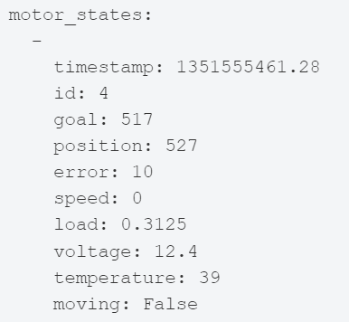
Test the launch file
roslaunch the_walker controller_manager.launch
rostopic list
/motor_states/robot_port
/rosout
/rosout_agg
rostopic echo /motor_states/robot_port

Slide 24
ROS Services
In some robot applications, a publish/subscribe model will not be enough if it needs a request/response interaction.
The publish/subscribe model is a kind of one-way transport system and when we work with a distributed system, we might need a request/response kind of interaction.
We can define a service definition that contains two parts; one is for requests and the other is for responses.
Using ROS Services, we can write a server node and client node. The server node provides the service under a name, and when the client node sends a request message to this server, it will respond and send the result to the client.
The client might need to wait until the server responds. The ROS service interaction is like a remote procedure call.

Slide 25
rosservice command line tool
$ rosservice call /service args: This tool will call the service using the given arguments
$ rosservice find service_type: This command will find services in the given service type
$ rosservice info /services: This will print information about the given service
$ rosservice list: This command will list the active services running on the system
$ rosservice type /service: This command will print the service type of a given service
$ rosservice uri /service: This tool will print the service ROSRPC URI

Slide 26
ROS Action
In ROS services, the user implements a request/reply interaction between two nodes
It may take too much time or the server is not finished with the given work, we have to wait until it completes.
There is another method in ROS in which we can preempt the running request and start sending another one if the request is not finished on time as we expected.
Actionlib packages provide a standard way to implement these kinds of preemptive tasks. Actionlib is highly used in robot arm navigation and mobile robot navigation. We can see how to implement an action server and action client implementation.

Slide 27
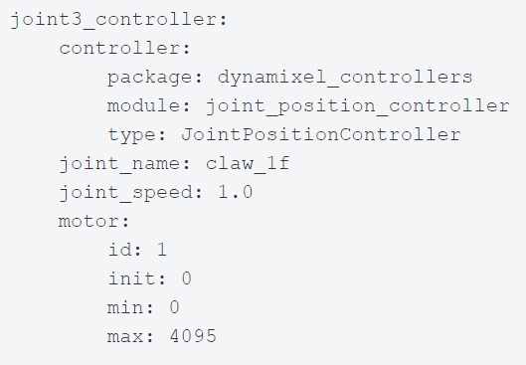
Creating a meta controller
Meta controller is an action server that allows you to group up any number of motors and control it by an action client.
Specify controllers parameters
First we need to create a configuration file that will contain all parameters that are necessary for our controller. Paste the text below following into tilt.yaml file:
motors.yaml

Slide 28
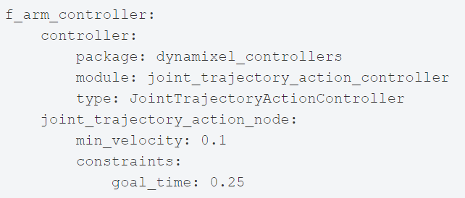
Specify meta controller parameters
We need to create a configuration file that groups all controllers and made it an action server.
jtac.yaml

Slide 29
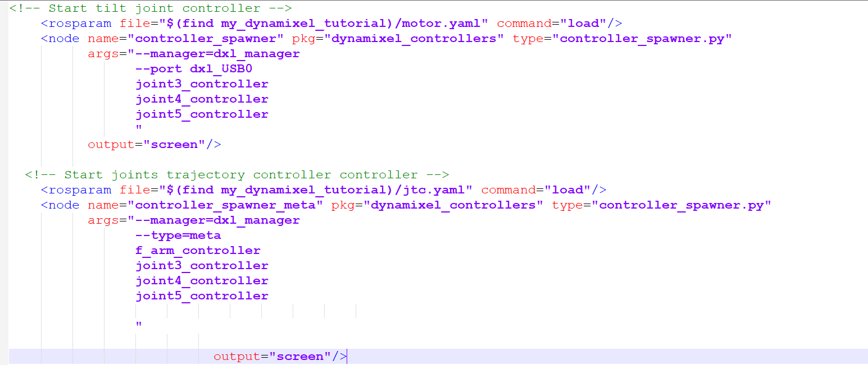
Create a launch file
We need to create a launch file that will load controller parameters to the parameter server and start up the controller.
motor_controller.yaml

Slide 30
Let’s test the controller
roslaunch the_walker motor_controller.launch
rostopic list
/motor_states/robot_port
/joint3_controller/command
/joint3_controller/state
/joint4_controller/command
/joint4_controller/state
/joint5_controller/command
/joint5_controller/state
/rosout
/rosout_agg
rostopic echo /joint3_controller/state
rostopic pub -1 /joint3_controller/command std_msgs/Float64 2.0

